Slide 1
The Comprehension Process MODULE
By Sarah Tantillo, Ed.D., LLC
Notes:
© 2020 by Sarah Tantillo, Ed.D., LLC @ www.literacycookbook.com

Slide 2
Objective: Review the comprehension process and apply it IN ORDER TO strengthen literacy instruction.

Slide 3
Notes:
Quick commercial interruption: This module is based on my Website…

Slide 4
TLC Blog
Notes:
And my BLOG…

Slide 5
Notes:
…and in my book.

Slide 6
Notes:
…and in my book.

Slide 7
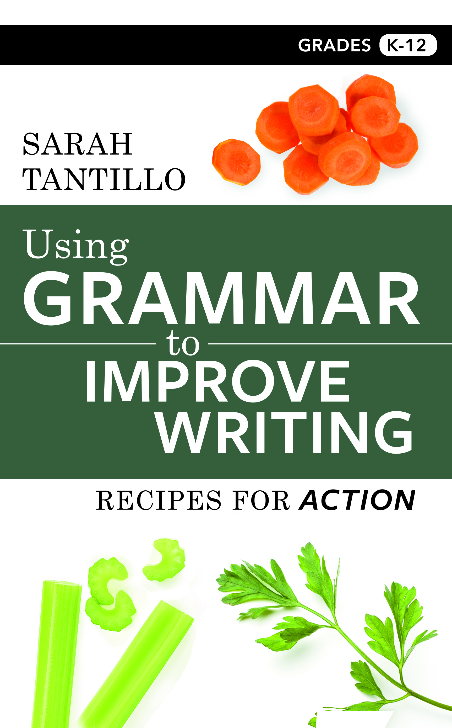
Notes:
…and in my book.

Slide 8
What is The Comprehension Process?
Notes:
“I’m going to explain my theory of comprehension using a sample text made of words. Then we’re going to apply this theory to a basketball game. Then we’ll apply it to a sample picture.”

Slide 9
SAMPLE TEXT:
“The man fell down.”
Notes:
So we have this sample text…

Slide 10
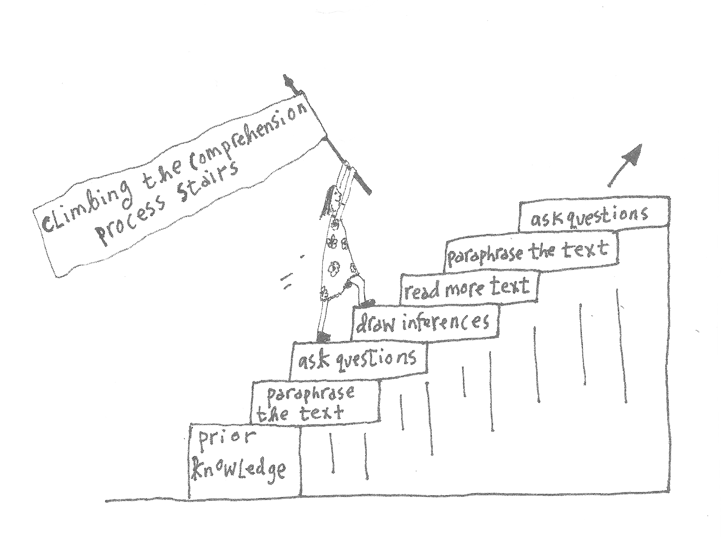
Notes:
Explain the illustration and how it shows The Comprehender building knowledge. HOW WOULD IT HELP STUDENTS TO KNOW THIS? Discuss what happens when students have VERY LITTLE PK/S, etc. Then, WE DO with a point guard READING the defense. Then explain the Quadrant Analysis Approach with the MLK photo.

Slide 11
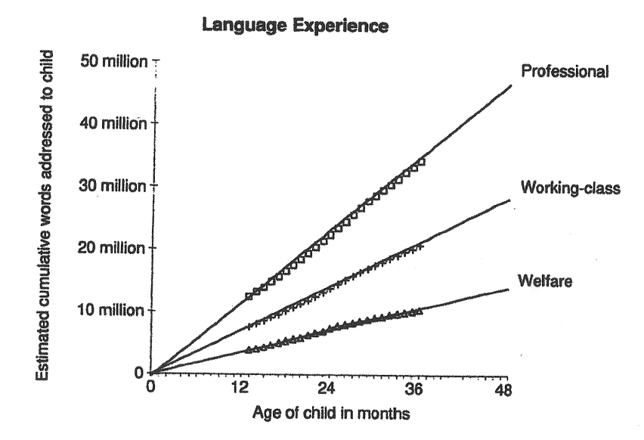
Notes:
This graph comes from MEANINGFUL DIFFERENCES in the Everyday Experience of Young American Children by Betty Hart and Todd Risley (Baltimore: Paul H. Brookes Publishing, 1995).

Slide 12
Notes:
Explain the illustration and how it shows The Comprehender building knowledge.

Slide 13
RIT 2.1: Ask and answer such questions as who, what, where, when, why, and how to demonstrate understanding of key details in a text.

Slide 14
Notes:
Explain the illustration and how it shows The Comprehender building knowledge.

Slide 15
Accumulation of inferences
+ info=
MAIN IDEA/ ARGUMENT
Notes:
All of these things ADD UP.

Slide 16
Notes:
When students miss inferences, it’s like missing pieces of a jigsaw puzzle. They might not be able to figure out what the main message is.

Slide 17
Notes:
Explain the illustration and how it shows The Comprehender building knowledge.

Slide 18
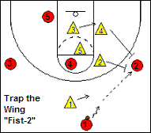
Notes:
Now let’s try this together. Pretend I’m a point guard and I need to “READ” the defense. What do I do first? Then? Etc.

Slide 19
Notes:
We are to run through the steps, applying the comprehension process to the photo.
TALK ABOUT THE QUADRANT ANALYSIS APPROACH.

Slide 20
1
2
3
4
Notes:
First, break the image into 4 quadrants and number them for easy reference.

Slide 21
Describe what you SEE.
Ask QUESTIONS about what you see.
Draw INFERENCES.
1
2
3
4
Notes:
Then, for each quadrant, do these three steps. For example, in Quadrant 1: What do we see? What questions do we have? What might we infer? Then for Quadrant 2, same thing….

Slide 22
Notes:
THEN, come back to the WHOLE image. What seem to be some MAIN MESSAGES?

Slide 23
Key takeaways?

